Slide 1

Branch and bound
Pasi Fränti
15.10.2018

Slide 2
General search strategies
Backtracking
Explore all alternatives
Solution constructed by stepwise choices
Decision tree
Guarantees optimal solution
Exponential time (slow)

Slide 3

Knapsack problem
Simplified
Input: Weight of N items {w₁, w₂, ..., w_{n}}
Knapsack limit S
Output: Selection for knapsack: {x₁,x₂,…x_{n}}
where x_{i} ∈{0,1}.
5
3
Sample input:
c_{i}=w_{i}={2,3,5,7,11}
S=15
7
2
11
Max 15

Slide 4
Knapsack as decision tree
w_{i}={2,3,5,7,11}
Yes
No
Chooce 2
2
-
Yes
No
Yes
No
Max 15
Chooce 3
5
2
3
-
Yes
No
Yes
No
Yes
No
Yes
No
Chooce 5
10
5
7
2
8
3
5
-
Yes
Yes
No
Chooce 7
17
10
12
5
5
14
9
2
15
8
10
3
12
5
7
-
…
…
No
…
…
28
12
14
13
26
15
12
-

Slide 5
Bounding criterion
Brute force: search full tree
Greedy:
take if fits in
2
-
O(2^{N})
N choices
5
2
3
-
10
5
7
2
8
3
5
-
17
10
12
5
5
14
9
2
15
8
10
3
12
5
7
-
…
…
…
28
10
12
14
13
26
15
12
-

Slide 6
Bounding criterion
Σ+w_{next} > S
Must be sorted!
w_{i}={2,3,5,7,11}
Chooce 2
2
-
Chooce 3
5
2
3
-
Chooce 5
10
5
7
2
8
3
5
-
Chooce 7
12
5
5
14
9
2
15
8
10
3
12
5
7
-
Chooce 11
13
14
11

Slide 7
Empty space for notes

Slide 8
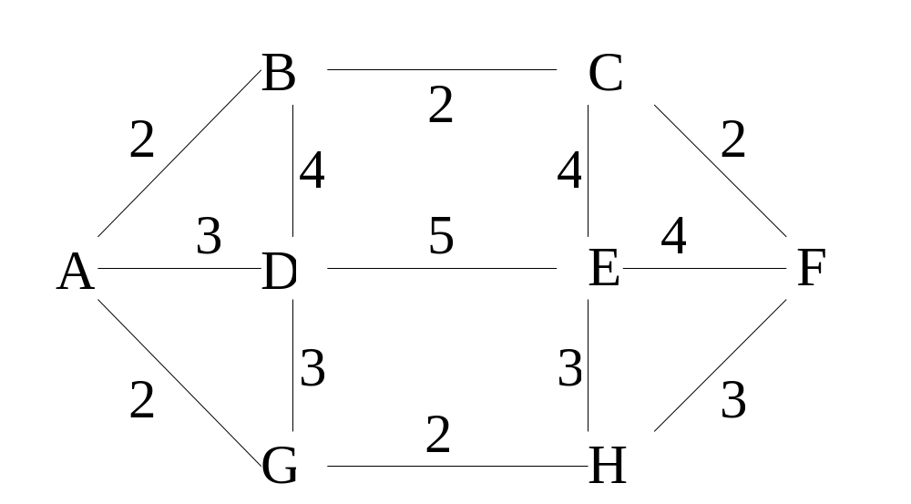
Traveling salesman problem
Input: Graph (V,E)
Problem: Shortest tour visiting all nodes.
Closed loop:
Open loop:
Optimal = A-B-C-F-H-E-D-G-A
Length = 22
Optimal = D-G-A-B-C-F-H-E
Length = 17

Slide 9
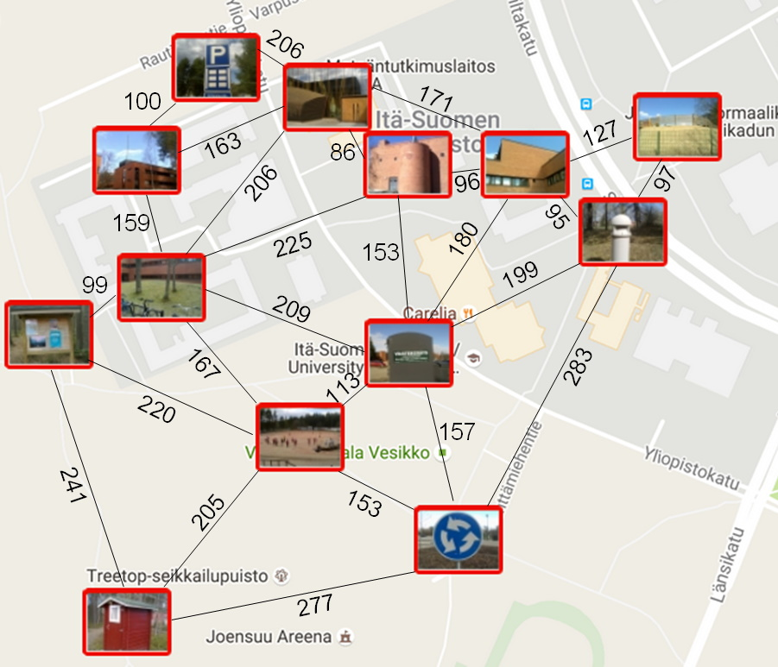
Brute force TSP
Brute force: search full tree
O(N!)
2
1
2
277
283
153
157
2
2
2
2
2
1
2

Slide 10
Bounding criterion 1
Best found so far
28
Best candidate:
B
6
A
4
2
5
G
C
E
1
D
6
4
H
F
32
New so far:
17
B
A
15
G
C
E
5! = 120
combinations
D
H
F

Slide 11
Bounding criterion 2
Nearest neighbors
28
All nodes must be visited.
Find the smallest possible incoming link.
Best candidate:
17
B
A
4
G
C
E
4
1
3
D
1
3
H
F
16
4+1+1+3+3+4
33
Lower bound:

Slide 12
Empty space for notes

Slide 13
Knapsack problem
Branch-and-bound
w_{i}={2,3,5,7,11}
0
2
Max 15
2
0
3
3
5
2
3
0
5
5
5
5
12
5
9
2
10
3
7
0
7
7
7
7
12
5
9
2
10
3
11
0
11
11
11
13
2
14
3
11
0

Slide 14
Traveling salesman problem
A
2
3
G
2
B
D
4
D
6
7
6
C
B
G
8
6
9
E
F
11
E
G
9
C
12
11
13
11
13
F
F
H
D
15
C
F
15
E
15
14
13
17
F
F
17
F
H
G
16
20
17
D
H
H
G
20
22
22
20
G
24
27
G
24
D
23
A
D
A
A

Slide 15
Traveling salesman problem
Input: graph (V,E)
Problem: Find shortest path via all nodes and returning to start node.

Slide 16
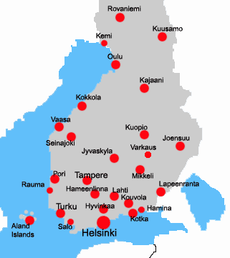

Just in case
if needed
117
110
216
246
199
182
121
170
315
231
79
142
242
136
191
148
78
191
126
120
178
149
116
89
234
170
51
112
79
131
109
163
73
86
143
72
90
63
53
59
58
105
27
116
135

